Slide 1
Biobank & Biospecimen Management System
Name : Malak Mohamed Abouelwafa
ID : 231002183

Slide 2
2
PROJECT OVERVIEW
Requirements & scope
Defined biobank lifecycle, assumptions and business rules.
Conceptual design
13 relational tables, PK/FK structure and ER relationships.
M:N relationship
Researcher ↔ Research Project resolved by researcher_project.
3NF normalization
Atomic attributes, full key dependency and no transitive dependency.
Implementation
MySQL DDL, constraints and indexes.
SQL operations
Retrieval, JOIN, aggregation, subquery, INSERT, UPDATE and DELETE.
Advanced objects
Two views, one trigger and one stored procedure.
Testing
SQL operations, views, trigger, procedure and FK integrity validated.

Slide 3
3
Problem Statement
The problem
Biobanks manage highly connected information about donors, consent, collections, samples and research.
Unstructured or duplicated records can cause inconsistent information and make sample traceability difficult.
Sample usage must be controlled because recorded consumption cannot exceed the available specimen volume.
Database solution
Centralized relational structure with primary and foreign keys.
Traceability from donor → collection → sample → aliquot/storage → research use or testing.
Integrity constraints and database-level logic reduce invalid data and business-rule violations.

Slide 4
4
Project Scope
Donor Registration
Consent
Collection Event
Sample Creation
Aliquot
Storage Location
Research Testing / Usage
In scope
Donors, consent, collections, samples, storage, aliquots.
Researchers, projects, laboratory tests and sample usage.
Assumption
Donor information uses anonymized donor codes rather than real patient-identifying information.

Slide 5
5
Business Rules
BR1 • Unique donor code
Each donor must have a unique identifier.
BR2 • Collection ownership
Each collection event belongs to one donor.
BR3 • Sample ownership
Each sample belongs to one collection event and one sample type.
BR4 • Aliquot storage
Each aliquot is associated with one storage location.
BR5 • M:N research
Researchers and projects connect through researcher_project.
BR6 • Volume safety
Sample usage must be positive and cannot exceed remaining volume.

Slide 6
6
13 Entities / Tables
BIOSPECIMEN CORE
RESEARCH
LABORATORY
• Donor
• Researcher
• Test Type
• Consent
• Research Project
• Test Request
• Sample Type
• Researcher Project
• Sample Usage
• Collection Event
• Sample
• Storage Location
• Aliquot
7 tables
3 tables
3 tables

Slide 7
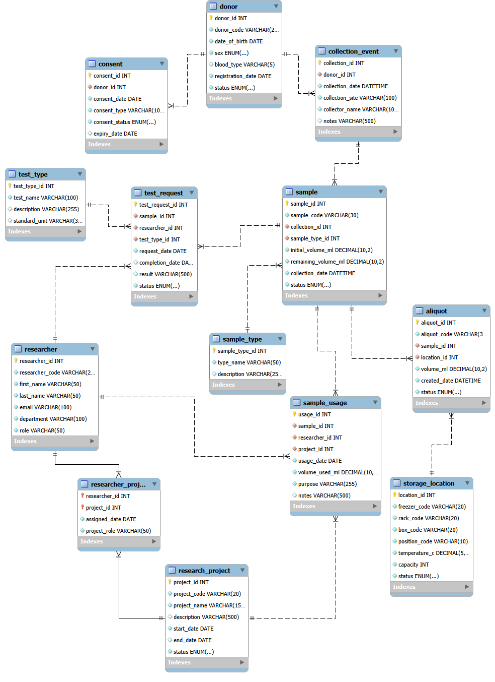
7
Entity–Relationship Diagram

Slide 8
8
Key Relationships
Relationship | Cardinality | Meaning
Donor → Consent | 1 : M | A donor may have multiple consent records.
Donor → Collection Event | 1 : M | A donor may have multiple collection events.
Collection Event → Sample | 1 : M | One event can produce multiple samples.
Sample Type → Sample | 1 : M | One type classifies many samples.
Sample → Aliquot | 1 : M | A sample can be divided into multiple aliquots.
Storage Location → Aliquot | 1 : M | A location can store multiple aliquots.
Researcher ↔ Research Project | M : N | Resolved through researcher_project.
Sample → Test Request | 1 : M | A sample can have multiple tests.
Sample → Sample Usage | 1 : M | Sample consumption is recorded per usage event.

Slide 9
9
Many-to-Many Relationship: Researcher ↔ Research Project
RESEARCHER
RESEARCHER_PROJECT
RESEARCH PROJECT
M
M
Why associative table?
Relational DBMSs implement M:N through two 1:M relationships.
It prevents repeating researcher/project information.
Composite primary key
researcher_id + project_id uniquely identifies an assignment.
Relationship attributes
assigned_date and project_role describe the assignment itself.

Slide 10
10
Relational Schema: Keys & Relationships
Table | Primary Key | Foreign Key
DONOR | donor_id PK | donor_code UNIQUE
CONSENT | consent_id PK | donor_id FK
COLLECTION_EVENT | collection_id PK | donor_id FK
SAMPLE | sample_id PK | collection_id FK; sample_type_id FK
ALIQUOT | aliquot_id PK | sample_id FK; location_id FK
RESEARCHER_PROJECT | researcher_id PK/FK; project_id PK/FK | Composite PK
TEST_REQUEST | test_request_id PK | sample_id; researcher_id; test_type_id FKs
SAMPLE_USAGE | sample_usage_id PK | sample_id; researcher_id; project_id FKs

Slide 11
11
Normalization to Third Normal Form (3NF)
1NF
2NF
3NF
ATOMIC ATTRIBUTES
FULL KEY DEPENDENCY
NO TRANSITIVE DEPENDENCY
Each field stores a single value; no repeating groups or multi-valued fields.
Non-key attributes depend on the complete key; especially important for researcher_project.
Non-key attributes depend only on the primary key. Related classification/details are separated.

Slide 12
12
MySQL Implementation & Project Files
Biobank and Biospecimen Management System.sql
DDL, tables, PKs, FKs, constraints and indexes.
Implementation environment
MySQL as the relational DBMS.
MySQL Workbench used for database creation, SQL execution, object inspection and ER modeling.
Primary keys and foreign keys enforce entity identity and referential integrity.
load_data.sql
Meaningful test data for the relational tables.
queries.sql
SELECT, JOIN, aggregation, subquery, INSERT, UPDATE and DELETE.
views.sql
Two reusable database views.
triggers_procedures.sql
Trigger and stored procedure.

Slide 13
13
SQL Operations
The database supports retrieval, joins, aggregation, subqueries and data modification.
-- Retrieval SELECT * FROM donor;
-- Subquery SELECT sample_code, remaining_volume_ml FROM sample WHERE remaining_volume_ml > (SELECT AVG(remaining_volume_ml) FROM sample);
-- JOIN SELECT d.donor_code, s.sample_code, s.status FROM donor d JOIN collection_event ce ON d.donor_id = ce.donor_id JOIN sample s ON ce.collection_id = s.collection_id;
Data modification
INSERT — create a valid test record.
UPDATE — modify an existing record using a key-based WHERE condition.
DELETE — remove a temporary test record safely.
-- Aggregation SELECT d.donor_code, COUNT(s.sample_id) AS sample_count FROM donor d JOIN collection_event ce ON d.donor_id = ce.donor_id JOIN sample s ON ce.collection_id = s.collection_id GROUP BY d.donor_id, d.donor_code;

Slide 14
14
INSERT • UPDATE • DELETE
INSERT INTO researcher (researcher_code, first_name, last_name, email, department, role) VALUES ('TEST001','Test','Researcher', 'test.researcher@biobank.com', 'Testing','Temporary');
UPDATE donor SET status = 'Inactive' WHERE donor_id = 1;
DELETE FROM researcher WHERE researcher_code = 'TEST001';
.

Slide 15
15
Two Database Views
VIEW 01 — donor_sample_view
Combines donor and sample information through reusable joins.
Simplifies frequent donor/sample retrieval.
Example: SELECT * FROM donor_sample_view;
VIEW 02 — test_request_view
Combines test requests with related samples, researchers and test types.
Simplifies laboratory test review.
Example: SELECT * FROM test_request_view;

Slide 16
16
Trigger & Stored Procedure
TRIGGER — check_sample_usage_volume
Executed BEFORE inserting a sample_usage record.
Checks that requested usage volume is positive.
Checks that requested volume does not exceed the sample's remaining volume.
Prevents physically impossible sample usage.
SHOW TRIGGERS;
PROCEDURE — get_donor_samples
Receives a donor identifier.
Retrieves biological samples associated with that donor.
Provides reusable donor-specific retrieval logic.
CALL get_donor_samples(1);

Slide 17
17
Testing Evidence
Test case | result
Donor retrieval | Correct donor records returned
JOIN query | Related donor/sample data returned
Aggregation | Sample counts calculated correctly
Subquery | Condition-based records returned
INSERT / UPDATE / DELETE | Test record lifecycle works
View 1 + View 2 | Expected joined data returned
Trigger | Invalid sample usage prevented
Stored procedure | Donor-specific samples retrieved
Foreign keys | Invalid references rejected

Slide 18
18
Live Demonstration Plan
01
02
03
04
Open schema
Explain design
Run JOIN
Run aggregation
Show tables and final ERD.
Highlight PK/FK relationships and researcher_project.
Show donor → collection → sample traceability.
Show sample counts per donor.
05
06
07
08
Run subquery
Open views
Advanced logic
CRUD
Show samples above average remaining volume.
Demonstrate both database views.
SHOW TRIGGERS + CALL get_donor_samples(1).
Briefly show safe INSERT → UPDATE → DELETE.

Slide 19
20
Project Outcome
What was achieved
Realistic biotechnology / biobank problem with defined scope.
13-table relational model with primary and foreign keys.
Multiple 1:M relationships and an M:N relationship resolved through an associative table.
Database normalized to Third Normal Form.
Required SQL operations, two views, a trigger and a stored procedure.
Testing performed in MySQL Workbench.

Slide 20
Thank You

